Slide 1


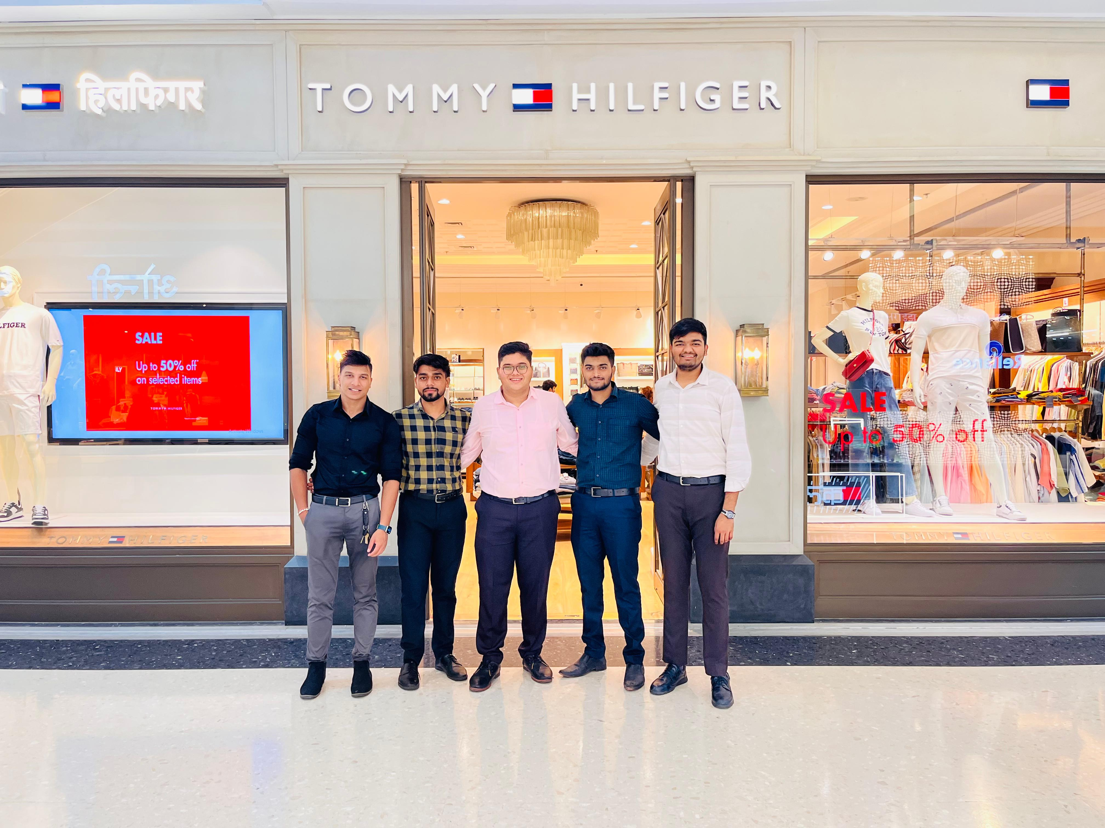
TOMMY HILFIGER
Presented By:- DEV MODI
RAJ MISTRY
PRANAV WAGH
MAYUR SHETTY
SHUDHANSHU SHARMA
TEJASVA AGRAWAL
Batch:- BILL GATES 2024

Slide 2
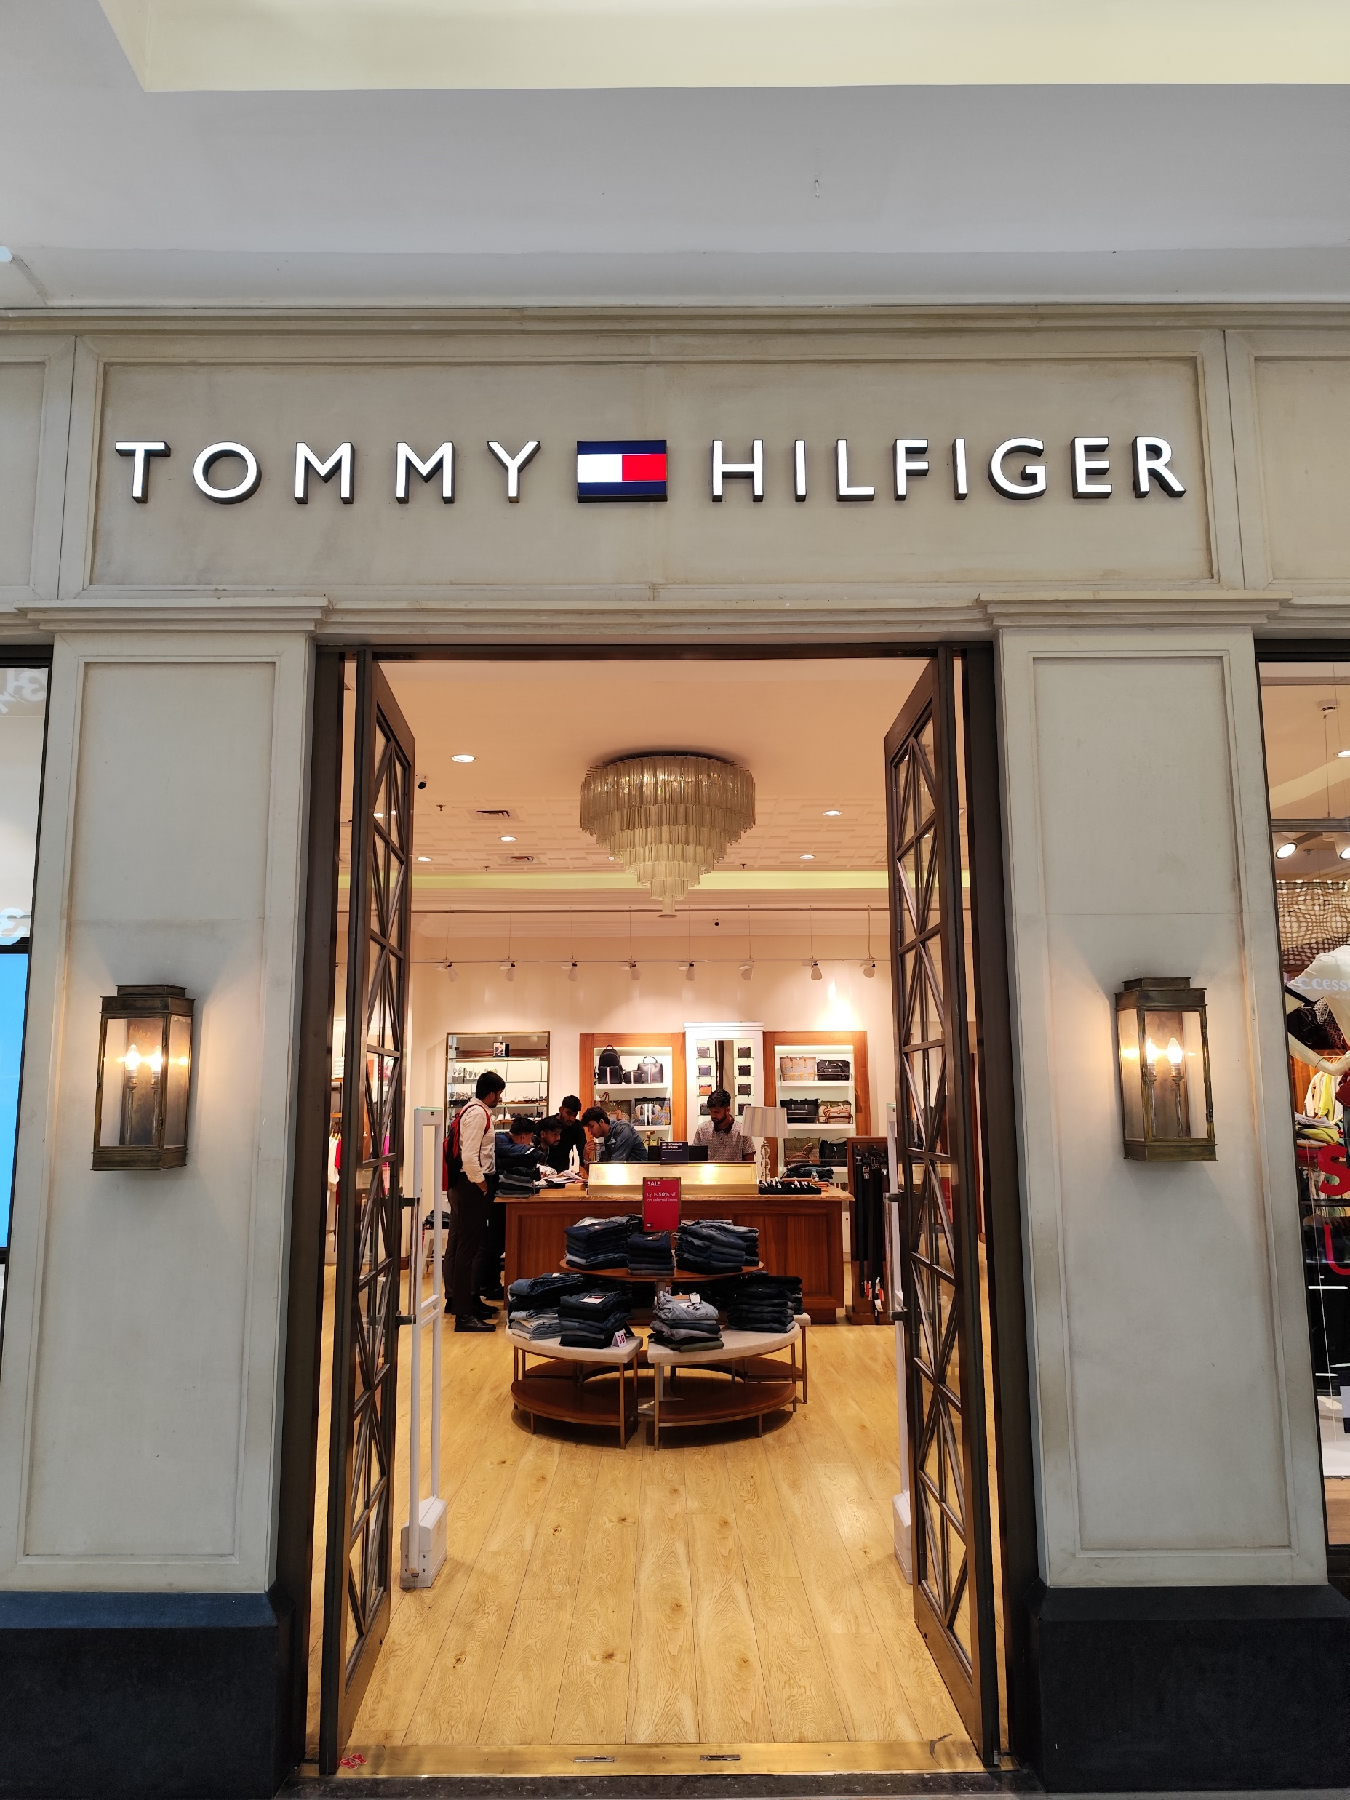
INTRODUCTION
Tommy Hilfiger, an iconic American fashion brand, was founded in 1985 by Tommy Hilfiger, a designer renowned for his signature red, white, and blue tag. Over the decades, the brand has evolved from its roots in classic American cool style, characterized by preppy aesthetics, to a global powerhouse in the fashion industry. Known for its timeless designs that blend tradition with modernity, Tommy Hilfiger offers a wide range of apparel, footwear, accessories, and home furnishings. The brand has successfully expanded its presence across numerous countries, appealing to a diverse clientele through innovative marketing strategies, celebrity endorsements, and a consistent commitment to quality and style. Tommy Hilfiger has maintained its relevance in a fast-changing industry by embracing digital transformation and sustainability initiatives, thereby ensuring its continued appeal to contemporary consumers.

Slide 3
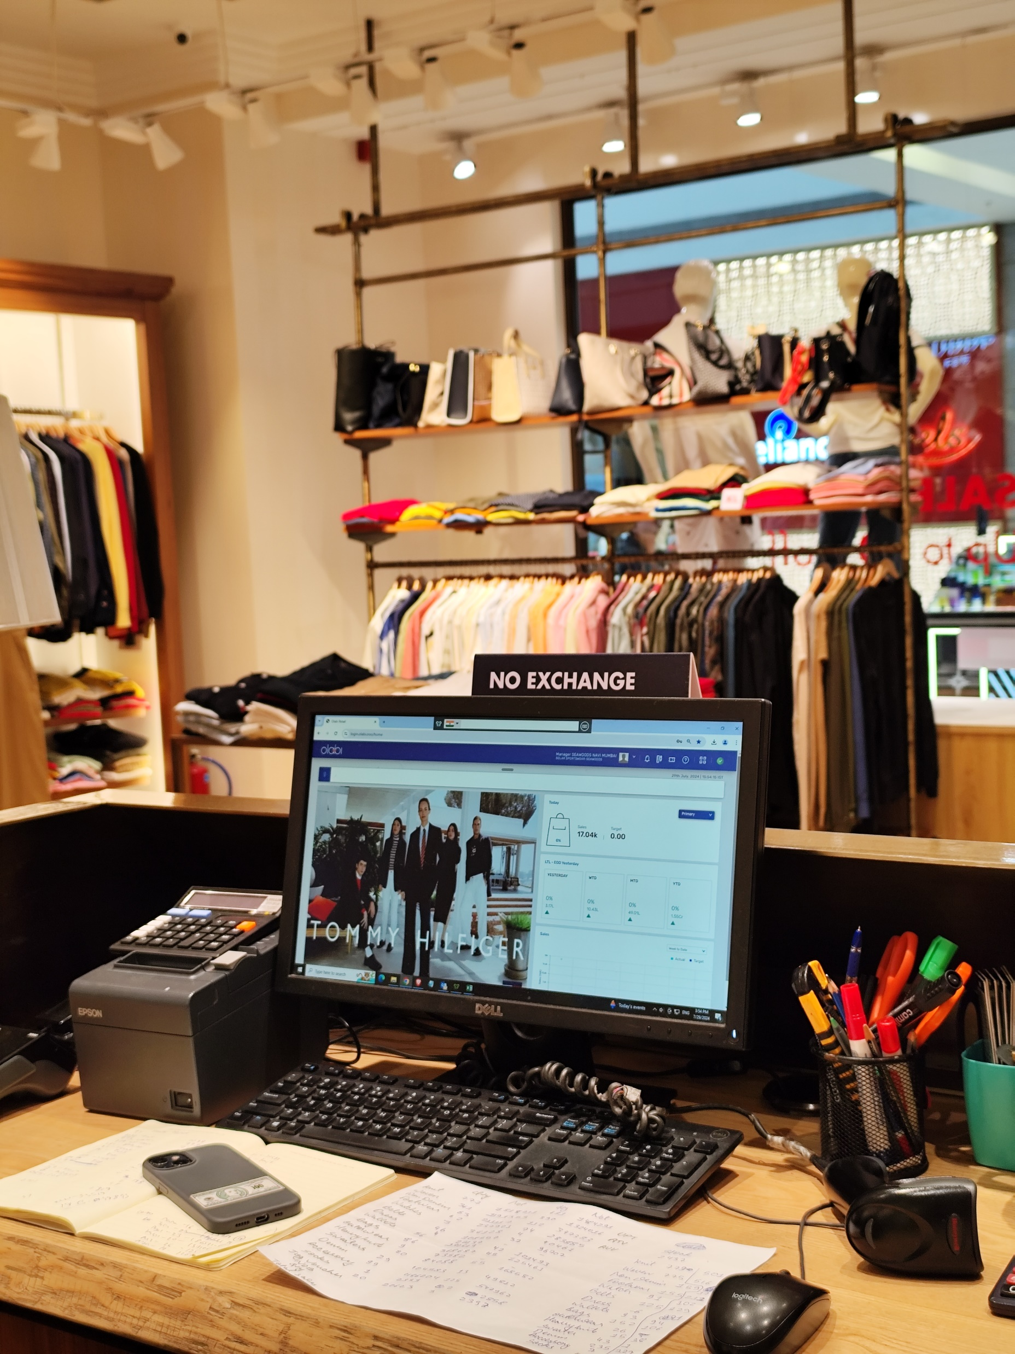
INFORMATION ABOUT TOMMY HILFIGER ERP SYSTEM
Type of Information System used:
Tommy Hilfiger used “OLABI” information System.
“OLABI Implementation - covering ERP, B2B trade processes and Brick & Mortar stores with POS system on its unified & seamless platform - has helped us to solve our technology challenges. With its advanced & futuristic Cloud enabled tech stack, we could digitally transform our business successfully and move on to a new phase of technology-fueled growth. "
Price of software:
OLABI software pricing decided as per retailer requirement .
Mostly they charges 8,000-9,000 Rs. per Month.

Slide 4
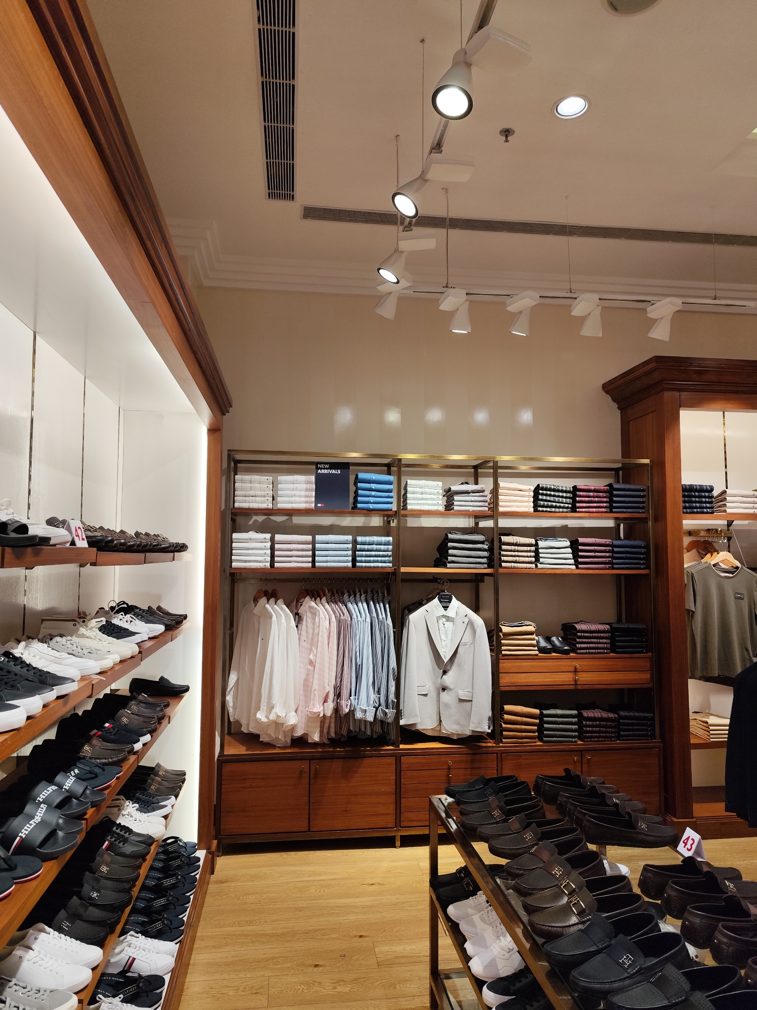
INFORMATION ABOUT TOMMY HILFIGER ERP SYSTEM
Challenges Faced by Employee:
Resistance to Change
Training and Skill Gaps
Data Migration Issues
System Integration
Customization and Flexibility
User Adoption and Utilization
System Downtime and Reliability
Cost Overruns and Budget Constraints
Change Management
Maintaining Customer Service Levels

Slide 5
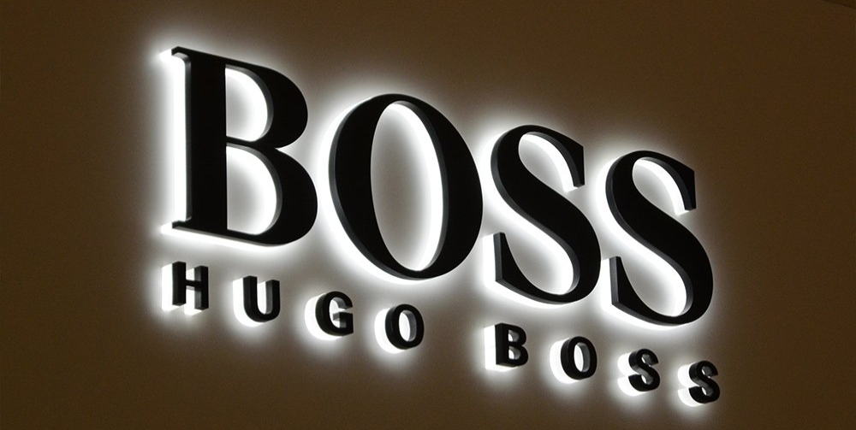
INFORMTION ABOUT COMPETITOR BRAND HUGO BOSS
Type of Information System used:
SAP ERP
Oracle Retail
Salesforce
IBM Watson
Price of software:
Mostly they charges 10,000-15,000 Rs. per Month.

Slide 6
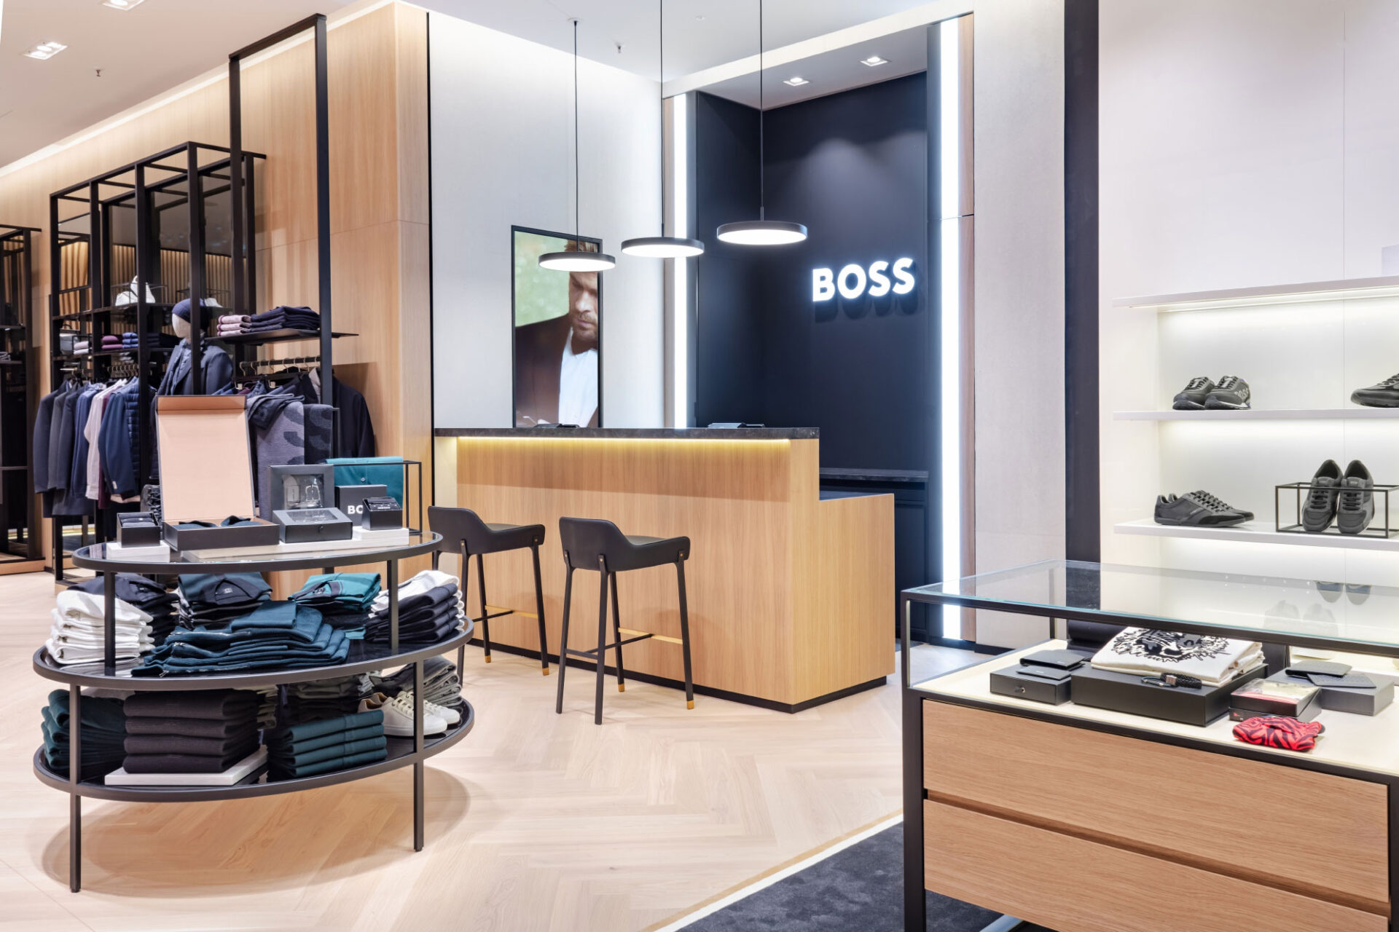
INFORMTION ABOUT COMPETITOR BRAND HUGO BOSS
Challenges Faced by Employee:
Balancing luxury brand image with cost-efficiency
Digital transformation
Data Migration Issues
Sustainability and ethical sourcing
Talent retention
Change Management
Maintaining Customer Service Levels

Slide 7
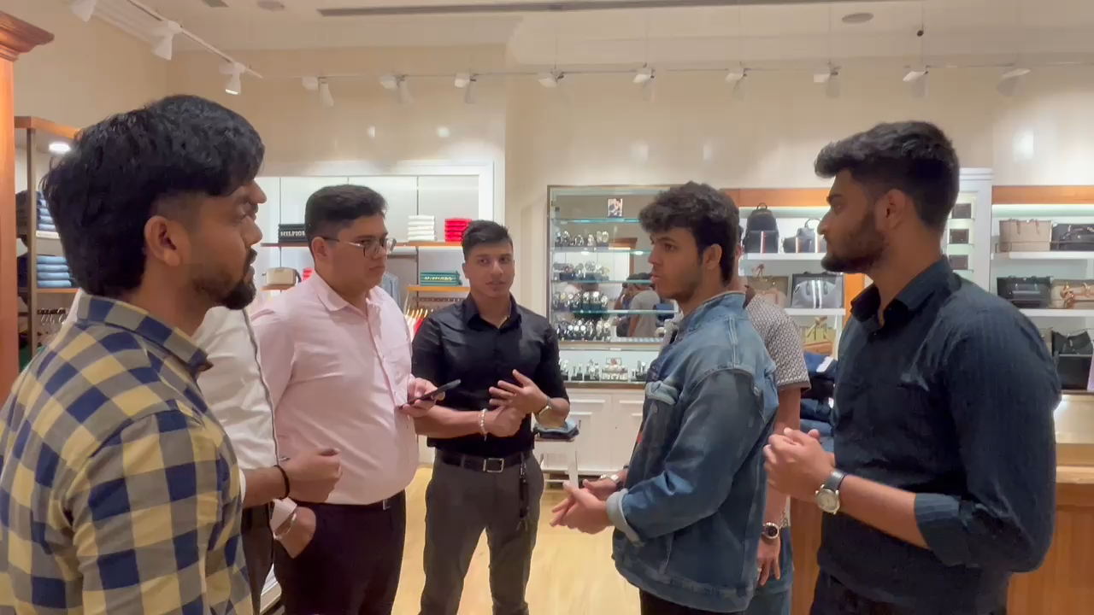
TESTIMONIALS

Slide 8
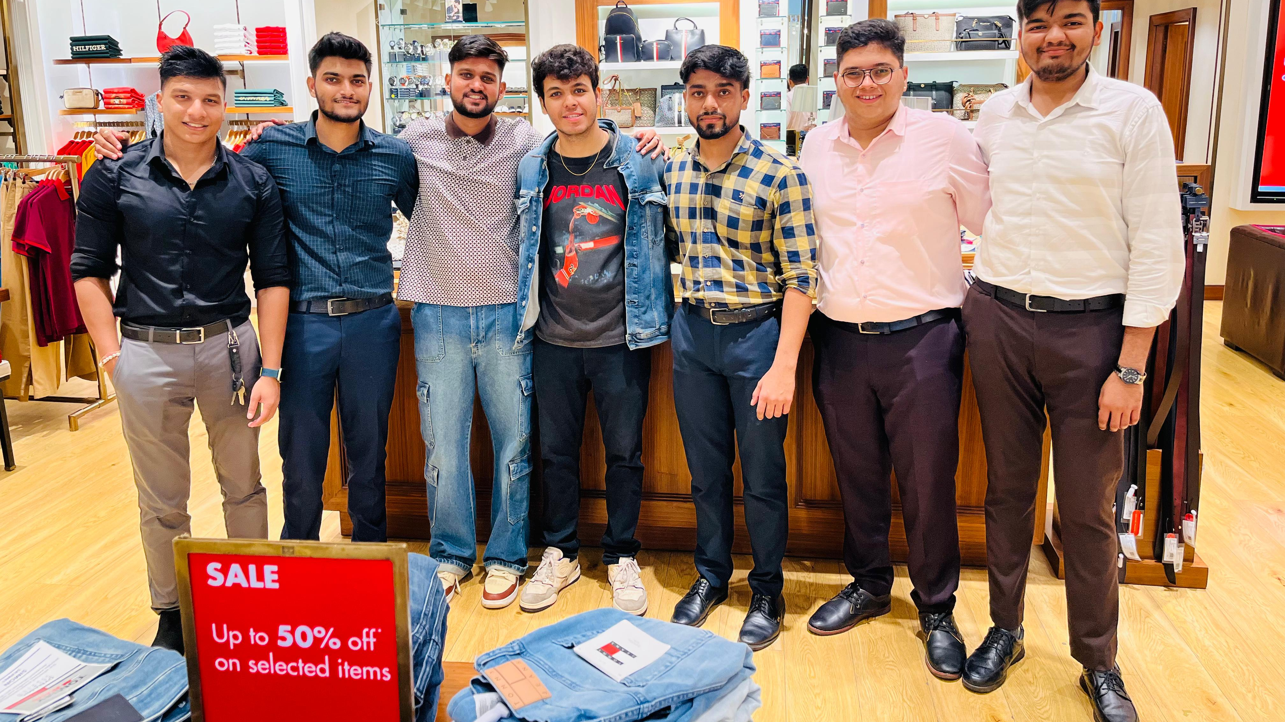
THANK YOU

